Slide 1
Bank Recommendation System
Recommendation Systems Prof. Raghuram Bhardwaj

Slide 2
Team Members
Subbhashit Mukherjee | MT2023065
Billa Abhignan | MT2023044
Aryan Yadav | MT2023013
Sai Hemanth | MT2023010

Slide 3
Agenda
Introduction
Our Pipeline
Dataset Creation
Techniques for recommendation
Result Analysis
Key Observations

Slide 4

Introduction

Slide 5
Why Bank Recommendation System?
As banking evolves in the digital age, traditional methods of customer engagement are proving inadequate in meeting the evolving needs and expectations of consumers. One pressing issue facing banks today is the challenge of customer dissatisfaction stemming from generic service offerings and lack of personalization. This dissatisfaction not only affects customer loyalty but also impedes the bank's ability to capitalize on cross-selling opportunities.
Throughout this presentation, we will delve into the pressing need for recommendation systems in banking, their potential to mitigate customer dissatisfaction, and the transformative impact they can have on overall customer experience and organizational success

Slide 6
Workflow
Data Collection and Enrichment: Collect extensive client, product, and demographic data, enhancing robustness and privacy with Gaussian Mixture Models (GMM) and Kernel Density Estimation (KDE).
Preprocessing: Standardize the dataset through cleaning, imputation, filtering, binning, and type conversion to ensure consistency.

Slide 7
Workflow
Client Segmentation and Analysis:
1) Use K-Means clustering to segment clients based on behavior patterns, enhancing targeted recommendations.
2) Apply distance metrics to tailor personalized offers and implement weighted distances for accurate product recommendations.
Advanced Modeling Techniques:
1) Utilize transformers for superior feature extraction and pattern recognition.
2) Employ Multi-Armed Bandit (MAB) strategies like Epsilon-Greedy, UCB, and
Thompson sampling to optimize strategic decision-making.

Slide 8

Our
Pipeline
Confidence-building strategies

Slide 9
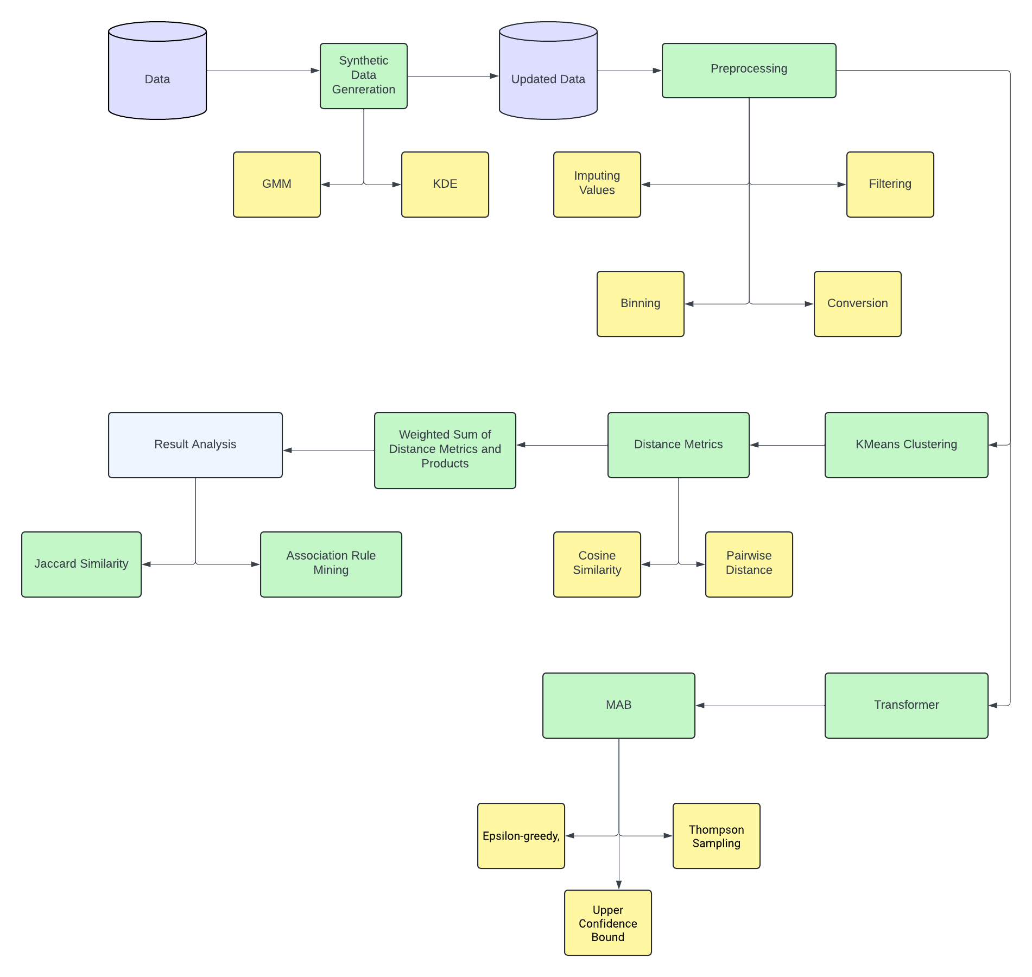

Slide 10

Dataset Creation

Slide 11
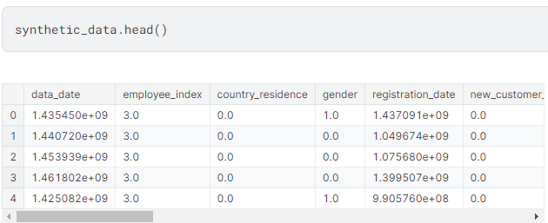
KDE
Implemented Kernel Density Estimation (KDE) to model density functions for numeric attributes in the VIP dataset, balancing detail with smoothness for synthetic data generation.
Added a post-processing step to align KDE-generated values with the nearest real values from the dataset, enhancing realism in the synthetic samples.

Slide 12
Advantages
Smooth Estimation: KDE provides a smooth estimation of the density that can capture more complex structures in the data compared to parametric methods. This smoothness is crucial for identifying subtle patterns in the data distribution.
Customizable Bandwidth: The bandwidth parameter in KDE allows for control over the smoothness of the resulting density estimate. A smaller bandwidth can capture more detailed features of the data distribution, while a larger bandwidth smooths out noise and outliers.
Handling Multi-Modality: KDE can effectively handle multi-modal distributions (distributions with multiple peaks). It can model each peak accurately without any inherent assumptions about the number of modes.

Slide 13
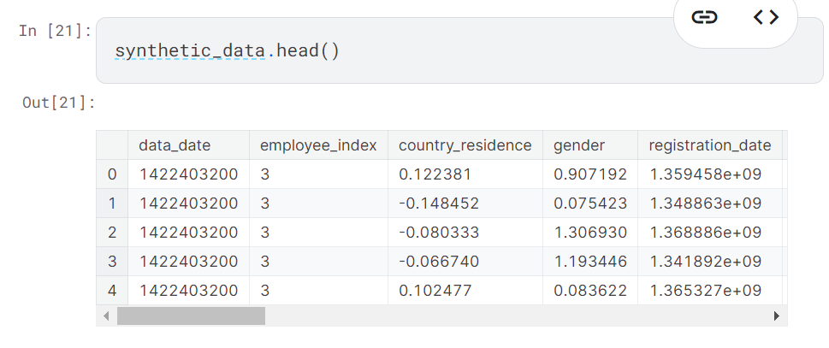
2. Gaussian Mixture Model
Combined Copulas with GMM to capture intricate variable dependencies, enhancing the accuracy of data generation.
Implemented a clipping mechanism to align generated data with actual values, ensuring the integrity and fidelity of the synthetic dataset.

Slide 14
Advantages
Complex Data Patterns: Our dataset exhibits complex patterns that cannot be adequately captured by a single Gaussian distribution. GMM allows us to model these intricate data structures by combining multiple Gaussian components.
Multimodal Distribution: The data shows evidence of multimodality, suggesting the presence of multiple clusters or groups within the dataset. GMM is well-suited for generating data with multimodal distributions, as it can represent each cluster with a separate Gaussian component.
Customizable Parameters: With GMM, we have control over various parameters such as the number of components, means, covariances, and weights of each component. This flexibility enables us to tailor the generated data to match the characteristics observed in our dataset.

Slide 15

Techniques For
Recommendation

Slide 16
Transformer
Our model takes a mix of categorical and numerical input data with 18 features and transforms it into dense embeddings. Then, it applies multi-head attention and feed-forward layers to capture feature interactions and nonlinear transformations.
After global average pooling, it predicts probability using a sigmoid output layer, optimized with Adam and evaluated with binary cross-entropy loss.

Slide 17
Advantages
Embedding Categorical Features: By embedding categorical features into dense vectors, the model can effectively capture relationships between categorical variables, which is crucial for tabular data analysis.
Attention Mechanism: The multi-head attention mechanism allows the model to focus on relevant features and learn complex interactions between them, improving its ability to handle dependencies within the data.
Non-linear Transformations: The feed-forward network introduces non-linear transformations to the data, enabling the model to capture intricate patterns and relationships that may exist in the tabular data.

Slide 18
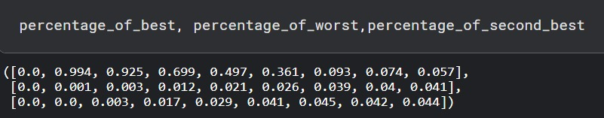
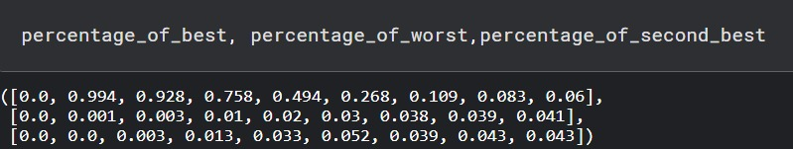
Epsilon Greedy and UCB
1st image: Epsilon and 2nd image UCB

Slide 19
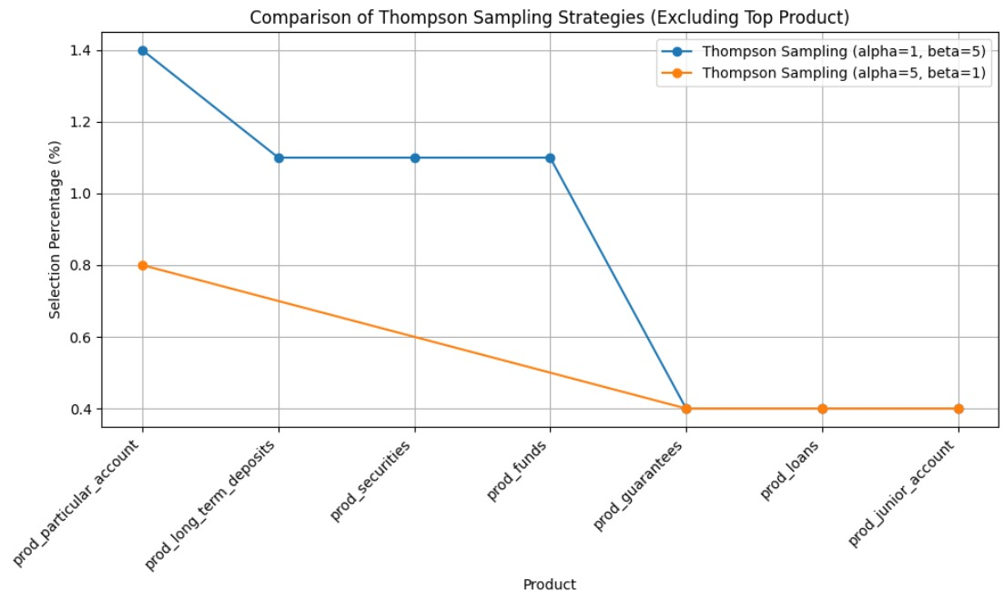
Thompson Sampling

Slide 20
Thompson Sampling
High Exploration in Thompson Sampling with alpha=5, beta=1
With alpha=5 and beta=1, Thompson Sampling explores a wider range of products compared to alpha=1, beta=5.
More Exploitation in Thompson Sampling with alpha=1, beta=5
With alpha=1 and beta=5, Thompson Sampling exhibits more exploitation compared to alpha=5, beta=1.

Slide 21
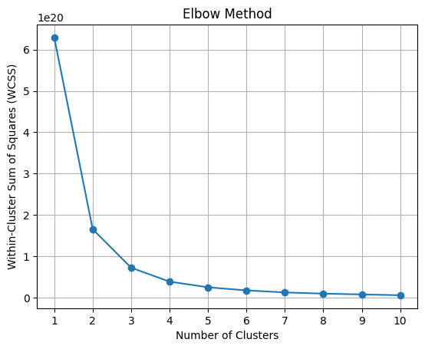
2. KMeans + Distance Metrics
Employed KMeans clustering on preprocessed data to categorize existing users into distinct groups.
Upon the arrival of a new user with substantial bank service usage, assigned them to the appropriate cluster.
Utilized cosine similarity and pairwise distance metrics to identify the top 10 customers closely resembling the new user's behavior.
Conducted a weighted sum calculation integrating product preferences and distance metrics to assign scores to each product.

Slide 22
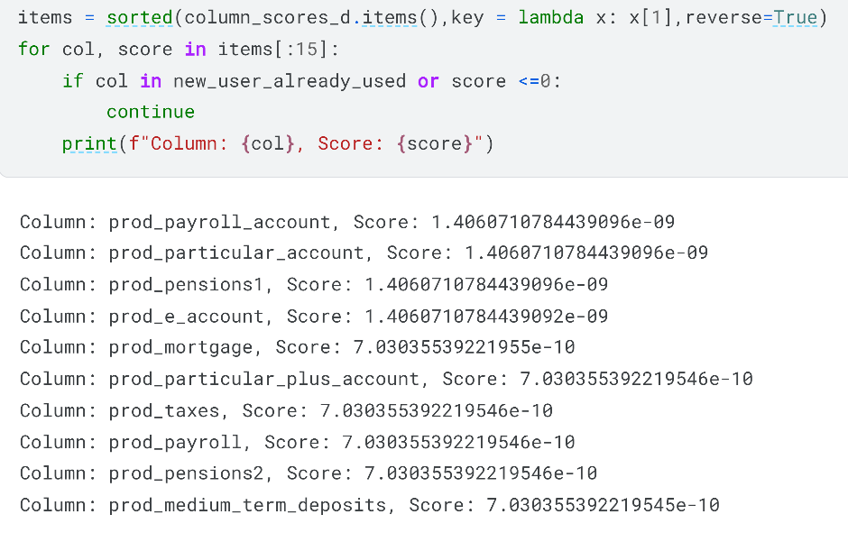
2. KMeans + Distance Metrics
Sorted products based on scores, prioritizing those with higher relevance to the user.
Utilized cosine similarity to evaluate the accuracy of recommended product categories based on the user's historical preferences.
Applied association rule mining techniques to elucidate the underlying reasons behind specific product matches and recommendations.

Slide 23
Advantages
Efficient Resource Allocation: Utilizing clustering algorithms like KMeans allows for efficient grouping of users, enabling targeted marketing efforts and resource allocation.
Accurate Recommendation: Leveraging distance metrics such as cosine similarity and pairwise distance ensures the identification of users with similar preferences, resulting in more accurate product recommendations.
Customized Scoring: Weighted sum calculation for product scoring considers both user preferences and similarity metrics, resulting in personalized scores that better reflect user interests.

Slide 24
Result
Analysis

Slide 25
Association Rule Mining
We have defined a custom function (search_association_rules) where user used products are given as input and these are searched in the product interactions of the users data, with the specified threshold of confidence = 0.1, lift = 5 and support = 0.02
Why we used this ?
Association rule mining is particularly effective in identifying patterns and relationships within large datasets.
Unlike some complex machine learning models, association rule mining provides transparent and explainable results.

Slide 26
Association Rule Mining
Example:
Antecedent: {Prod_taxes, Prod_direct_debit}
Consequent: {Prod_pensions2}
Support: 0.15 (15% of customers have both a prod taxes and a prod direct debit)
Confidence: 0.75 (75% of customers with a prod taxes and a prod direct debit also have prod pensions2)
Lift: 1.5 (Customers with both a prod taxes and a prod direct debit are 1.5 times more likely to have a prod pensions2 compared to customers in general)
Therefore, the bank can use this association rule to recommend the prod pensions2 to customers who already have a prod taxes and a prod direct debit.

Slide 27
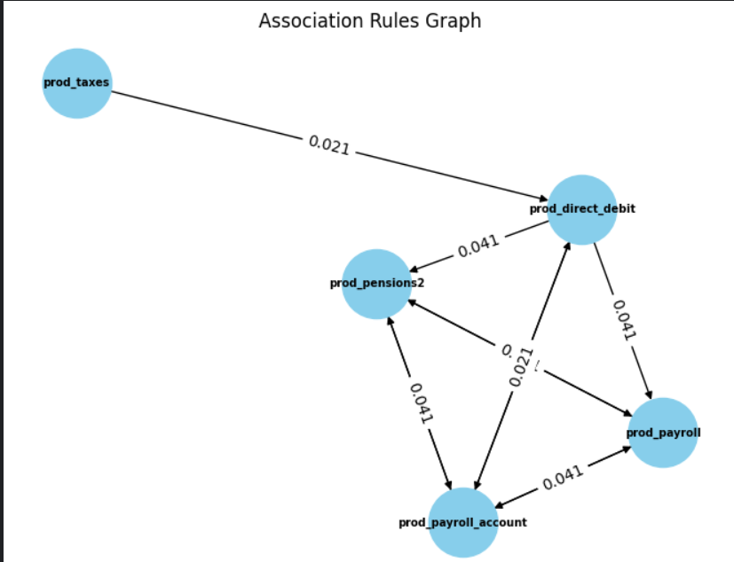
Association Rule Mining

Slide 28
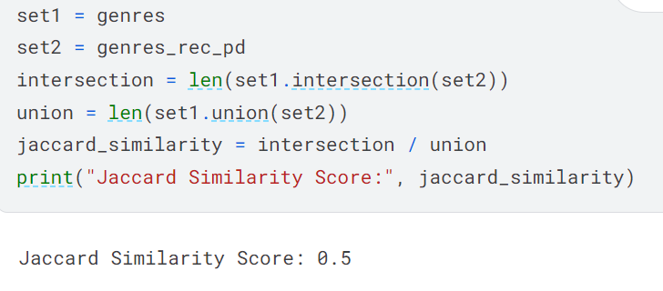
Jaccard Similarity
We used Jacardian Similarity for generating scores for input and prediction categories.Jaccard similarity is a measure used to compare the similarity and dissimilarity between two sets.
It's particularly useful when dealing with categorical data or sets where order doesn't matter. The Jaccard similarity is defined as the size of the intersection of the sets divided by the size of the union of the sets.

Slide 29
Jaccard Similarity
Advantages :
Scale-Invariant: Jaccard similarity is not affected by the size of the sets being compared. It only considers the presence or absence of elements, not their frequency or order.
Interpretability: The resulting Jaccard similarity score ranges from 0 to 1, where 0 indicates no similarity and 1 indicates complete similarity. This makes it easy to interpret the similarity between sets.
No Assumptions about Distribution: Jaccard similarity does not make any assumptions about the underlying distribution of the data. It operates solely based on set membership, making it applicable to a wide range of data types and distributions.

Slide 30

Key Observations

Slide 31
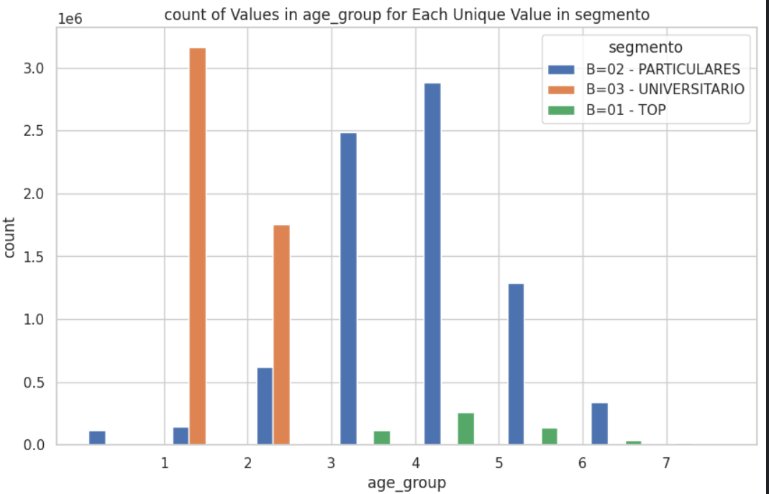
Based on data plots
When we analyze Age bins, we observed both (18,25] and (25,35] age groups have maximum customers from “University”.
“Particular” segmentation has the maximum share from age groups other than between age 18 to 35.

Slide 32
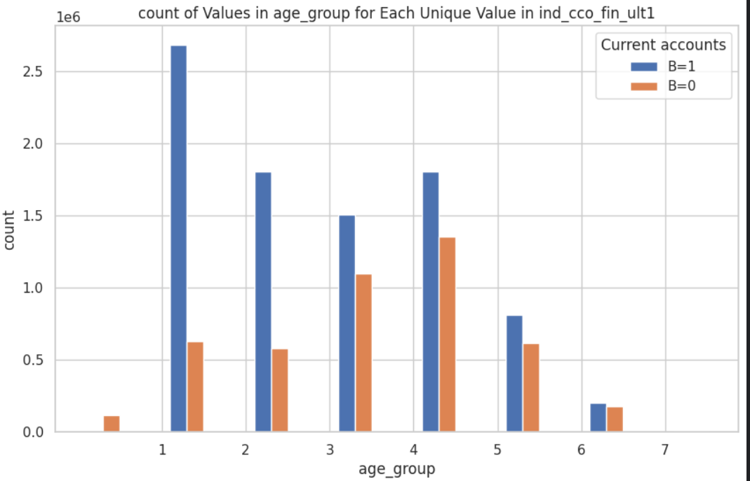
Based on data plots
“fecha_alta_month” (The month in which the customer became as the first holder of a contract in the bank), max enrollment happened in the month of October. (18,25].
This is probably because this age group usually starts college and they opened a Bank account, or because their first job started hence they need to open a bank account.

Slide 33
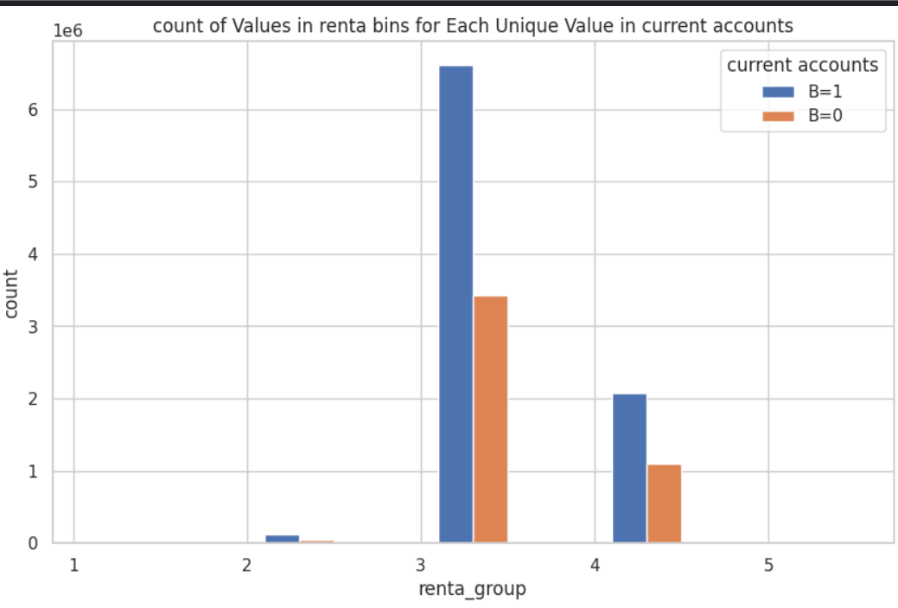
Based on data plots
We have divided the gross household income in an exponential bin of [0, 300, 3000, 30000, 300000, 3000000, 30000000, 300000000].
Maximum Customer opened Current accounts are in the income range from 30000 to 300000.

Slide 34
Category Based Recommendations
Users may not receive recommendations for certain category products even if related items were initially present.
Example:
If "PROD_PENSION1" is recommended, "PROD_PENSION2" might not be present and vice versa in “Pensions and Retirement”.
If "PROD_GUARANTEES" is recommended, "PROD_TAXES" might not be present and vice versa in “Other Financial Products”.

Slide 35
More Initial Products
Utilizing the KMeans + Similarity technique revealed a noticeable decline in recommendation quality when based on a limited initial product count (e.g., 2 or 3 selections).
Fewer initial products led to less diverse and potentially less accurate recommendations, highlighting the critical role of initial product count in recommendation effectiveness.
To address this challenge, a minimum requirement of 4 or 5 initial products was established to improve recommendation accuracy and relevance.
Encouraging users to provide a sufficient number of initial products enables the recommendation system to better capture user preferences, resulting in more personalized and effective recommendations.

Slide 36
Thank you

